Slide 1


CITS1003 Introduction to Cybersecurity [6] Vulnerabilities and Controls
Dr David Glance

Slide 2
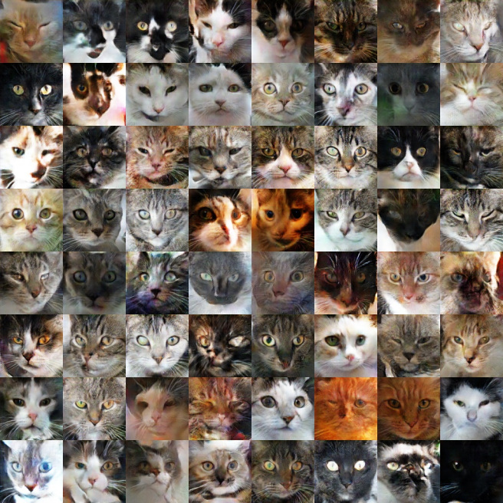
A unit about cats cybersecurity
Cats generated by a Generative Adverserial Network (GAN)
https://ajolicoeur.wordpress.com/cats/

Slide 3
3 things
Understand vulnerabilities and how they are rated and reported
1
Know the OWASP top 10 vulnerabilities
2
Understand how vulnerabilities can be mitigated using controls
3

Slide 4
Vulnerability
Vulnerability: weakness in an organisation’s assets that when exploited by a threat will lead to economic loss
ISO27005 Information Security Risk Management in the following areas:
Organization
Processes and procedures
Management routines
Personnel
Physical environment
Information system configuration
Hardware, software or communications equipment Dependence on external parties
We are mainly interested in the last 2

Slide 5
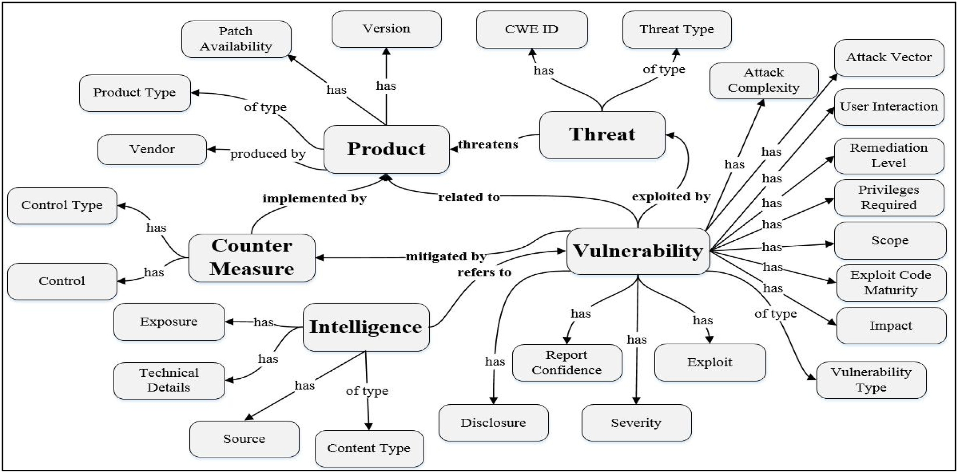
Cybersecurity Vulnerability Ontology
Syed, R. (2020) https://www.sciencedirect.com/science/article/pii/S0378720620302718

Slide 6
Vulnerability Reporting
When a vulnerability is discovered, it is usually reported to the organisation responsible for the product and they are given time to fix
Zero Day vulnerability is one that is unknown (or unfixed) by the manufacturer of the product when it is exploited
Vulnerabilities that are reported and then fixed, by a patch or upgrade of the software or product, is then reported for inclusion in public databases:
CVE Common Vulnerabilities and Exposures (https://cve.mitre.org/index.html)
NVD National Vulnerability Database (https://nvd.nist.gov/)
VulDB (https://vuldb.com/)
Disclosure comes with problems because it may help disseminate and promote exploits
There is a market for bug finding (Bug Bounties) and also for selling Zero Days

Slide 7
Vulnerability Scoring
Vulnerability scoring measures (NVD):
Attack vector: network, local, physical
Privileges required: None, low, high
User interaction: None, required
Impact on CIA: None, low, high
CWSS: more complex and based on 3 measures:
Base Findings: captures the inherent risk of the weakness, confidence in the accuracy of the finding, and strength of controls.
Attack Surface:: the barriers that an attacker must overcome in order to exploit the weakness.
Environmental :: characteristics of the weakness that are specific to a particular environment or operational context

Slide 8
Exploits and Proofs of Concept
Vulnerabilities are not really risks unless they are exploitable. In part, proving a vulnerability relies on showing how it can be exploited
Researchers often develop a proof of concept: a working way of exploiting a vulnerability
There are databases of known exploits to vulnerabilities: SearchSploit (and others) https://www.exploit-db.com/searchsploit

Slide 9
Vulnerability Sharing
Countries have Computer Emergency Response Teams (CERTs), but this term was trade marked by Carnegie Mellon University who started the first one in 1988
AusCERT is Australia’s but all countries have their own
Responsible for alerting organisations about specific vulnerabilities and threats

Slide 10
Example
AusCERT Security Bulletin Summary
Product: SpamAssassin
Publisher: Ubuntu
Operating System: Ubuntu
Impact/Access: Execute Arbitrary Code/Commands -- Remote/Unauthenticated
Resolution: Patch/Upgrade
CVE Names: CVE-2020-1946
SpamAssassin vulnerability 01 April 2021
SpamAssassin could be made to run programs if it opened a specially crafted file.
Releases o Ubuntu 20.04 LTS

Slide 11
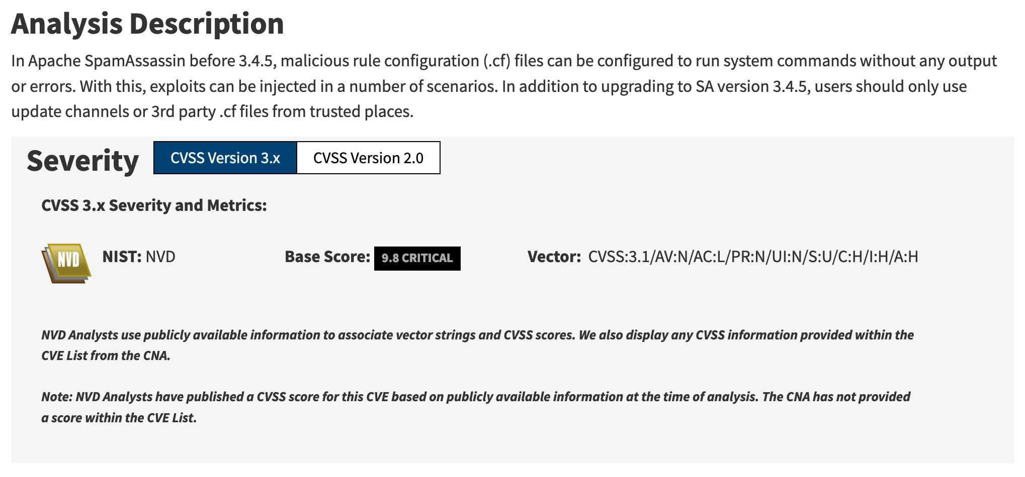
Example NVD

Slide 12
Network Vulnerabilities and Attacks 1
Vulnerabilities that directly involve networks and their protocols:
Network traffic is vulnerable to interception, being read and manipulated
Network services are vulnerable to poor availability by being overloaded
Sniffing: listening to traffic on a wired or wireless network (WiFi, Bluetooth, NFC)
May involve a “man-in-the-middle” attack
Wireless can be passively sniffed because it is broadcast
Spoofing: altering communications to pretend to be a different sender
e.g. Caller ID on an SMS or phone call, senders of emails
Usually done at the network level altering TCP/IP packets
Part of a man-in-the-middle attack

Slide 13
Network Vulnerabilities and Attacks 2
Denial of service
Flooding a service with fake requests so that real users can not access the service
Distributed Denial of Service (DDoS)
Using many sources for denial of service attacks including Internet of Things (IoT) devices
Man-in-the-middle attacks
Intercept network traffic to sniff the packets before passing them to the legitimate destination or to a destination under the attacker’s control
Hacking: Initial Access and Lateral Movement
Access a machine through the use of remote access services or through exploitation of vulnerabilities in a network service
Use a machine to “pivot” to other machines on the same, or different networks

Slide 14

Network Vulnerabilities

Slide 15


Network Sniffing
This 7 year old took 11 minutes to hack the WiFi in a Café after watching the howto on YouTube

Slide 16
Web Vulnerabilities
Some of the most common applications we use are web applications that are run by web servers. Examples include:
Banking website
Netflix
Amazon
They communicate with browsers and send code and media to display.
Some functionality is run on the browser, but important things like “transfer this money to my friend” are done on the server
There are numerous places where vulnerabilities can exist and there are common ones that occur

Slide 17
OWASP Top 10
Open Web Application Security project maintains a list of top 10 vulnerabilities:
They can be split into the following types of error:
Programming errors
Authentication
Input sanitization: Injection, Cross-Site Scripting (XSS)
Security and access
Configuration errors
Insufficient logging or monitoring
Security configuration
3rd party programming errors
Using components with known vulnerabilities

Slide 18
Finding Vulnerabilities: Scanning
Vulnerability scanning
Use tools that carry out an automated scan of the network and its services::
nmap
OpenVAS
BurpSuite
Nessus
These will look for vulnerabilities based on a database. They rely on being able to version software discovered accurately to be able to check if there are known vulnerabilities. i.e. it doesn’t try and exploit vulnerabilities

Slide 19
Finding Vulnerabilities: Penetration Testing
Penetration Testing (Ethical Hacking)
Professionals who use tools and their skills to look for vulnerabilities
Will operate within an agreed scope regarding what they can and can’t do
May be done as White Box, Grey Box or Black Box depending on how much information is provided about the network and the applications that are running on them
Red Teams
Teams of ethical hackers that will try and penetrate a network, sometimes adopting Tactics, Techniques and Procedures of known hacker groups
They may operate against a Blue Team that tries to defend against the attack
The purpose again is to highlight vulnerabilities
Sometimes Blue and Red teams are combined to form Purple teams

Slide 20
Implementing Controls
Implement Defense in Depth: i.e. have multiple layers of controls that implement security at each level
Traditionally, people implemented a perimeter firewall to protect company
This doesn’t work so well when everyone is working remotely
Partition the network into different functional concerns e.g. Departments in an organisation, servers from the administration network, staff from students.
Externally facing services like web servers put into a DMZ (Demilitarized Zone)

Slide 21

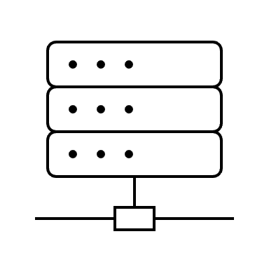



Network DMZ
Company Employee
Public
www.uwa.edu.au
DMZ

Slide 22
Computers
Computers are built up using a secure baseline image: configuration of Windows (for example) that has default user, system and security settings, certain software profiles
Can implement Australian Signals Directorate (ASD) Essential Eight:
Application control: prevent the execution of unapproved/malicious programs
Configure Microsoft Office macro settings
Restrict administration privileges
Multi-factor Authentication
Daily backups
Patching applications
Application hardening
Patch Operating Systems

Slide 23
Application Control
Vulnerability
Windows has a variety of scripting languages that can be used for malicious purposes
They can be run from the command line applications cmd.exe, powershell.exe and applications such as Microsoft Office (Word, Excel, PowerPoint) which runs VBScript and JScript (a form of JavaScript)
Although many attacks require a person to click on a link and allow a program or script to run, some do not need this.
Controls
General users should be prevented from running scripts in PowerShell and another scripting environment Windows Script Host (WSH)
Launching applications on Windows (anything with a file extension of .exe) can be checked against a AllowList and BlockList

Slide 24
Microsoft Office Macros
Vulnerability
Office has the ability to automate actions by running a Macro which is a piece of script that is labelled and associated with a key combination or some action such as opening a document
Malicious users can craft macros that steal information (C) or run malware (C,I, A)
Controls
Microsoft has made it harder to run macros because you need to agree to running them but that is not too hard with some users
Block macros in Office and train users
Declare PtrSafe Function GetUserNameA Lib "advapi32" ( _
ByVal NameType As Long, _
ByVal lpBuffer As String, _
ByRef nSize As Long _
) As Boolean
Sub GetUsername()
Dim Username As String * 256
GetComputerNameExA ComputerNameDnsDomain, DomainName, 256
Debug.Print “Username: “ & Username
End Sub

Slide 25
Restrict Administration Privileges
A user with administrator privileges can normally carry out all actions on a computer including installing programs and device drivers (software for printers, peripheral devices), managing user accounts, managing logging and auditing functions
On Linux and Windows there are special users root and Administrator but on consumer products main user is usually an administrator as well
Windows will now make explicit when a user needs to use administrative privileges
Vulnerability
Users are given administrator privileges when they don’t need these privileges for everyday use
Attackers who get access to these accounts then have increased access thanks to the privileges (C,I,A)
Controls
Limit the number of users who have administrator rights
Train users to use them judiciously
Monitor actions of anyone who uses these privileges

Slide 26
Multi-Factor Authentication
Normal authentication uses a single factor: a password (often referred to as “something you know” authentication type)
Factors sometimes defined as:
Type 1: Something you know
Type 2: Something you have
Type 3: Something you are or something you do
Somewhere you are
Context-Aware Authentication
Vulnerability
Attacker obtains username and password and uses it to gain unauthorised access (C – possibly I, A)
Controls
Multi-factor authentication makes it harder for attacker to use a username and password.
However, some second factors like SMS codes are relatively easy to get around

Slide 27
Daily Backups
Vulnerability
Access to files and information stored on a disk because of:
Disk failure
Lost device
Ransomware or deletion
Control
Daily backup
Cloud storage
Issues
Problems with how frequently you backup
Overheads of backups: storage, network use
Time to restore
Backup confidentiality, integrity and availability

Slide 28
Patching Applications and Operating System
A patch is a small update to application and operating system software that usually fixes bugs rather than introduces major features (referred to as an upgrade)
Vulnerability
Known vulnerabilities in software can be exploited by attackers
Issuing a patch tells attackers about vulnerabilities
Control
Update applications and operating system with patches as soon as they are available
Issues
Patches are often complicated and can impact the availability of systems themselves
Issuing a patch informs attackers about vulnerabilities and increases the attacks
User fatigue in constantly updating their systems

Slide 29
Application Hardening
Vulnerability
Many applications come with features and default settings that are insecure
Default passwords that are the same for each product
Examples are IoT devices, Routers, server software
Control
Harden application by removing default features and settings, setting new passwords

Slide 30
Anti-Malware Software
Anti-Malware software (AKA Anti-Virus) can be installed at endpoints (computers, mobile devices, tablets) or on edge devices like routers
Works in real-time scanning network traffic, scan file changes and can do disk scans
Works by looking for a range of indicators such as file signatures based on file hashes, presence of certain strings (text), use of system functionality that is not normal for applications
More recently anti-malware operates on behavioural analysis (anomaly-based): behaviour typical of malware, unexpected network traffic, attempts to change memory or other applications
This is increasingly done using machine learning techniques
Software also does other things now like looking for suspicious browsing, blocking websites that are known malware sites
Malware adapted and tries to evade (including anomaly-based software) and even disable anti-malware software

Slide 31
Intrusion Detection Systems
Intrusion detection system (IDS) can be network-based or host-based
Like anti-malware, uses knowledge-based and behavioural-based approaches to detection
Behavioural based approaches take a baseline of network traffic and other factors and looks for changes
IDS systems report back to a Security Information and Event Manager (SIEM) which can alert security staff of issues
IDS may take some active measure such as blocking traffic on finding an anomaly

Slide 32
Intrusion Protection Systems
Intrusion protection system (IPS) is usually placed inline in the network
Like IDS, uses knowledge-based and behavioural-based approaches to detection
IPS will take active measures to block malicious activity
Sometimes combined as IDPS
Open Source example Snort

Slide 33
Honeypots
A Honeypot is a system that is put on the network to lure attackers to attack it and not the real network
The honeypot is often isolated from any other network meaning that the attackers spend time trying to escape
Can be sophisticated and replicate multiple machines, services and users
Monitors attempts at probing and attacking
Gives a geographical picture of where attacks are originating from

Slide 34
Data Loss Prevention (DLP)
Systems that try and prevent data from being exfiltrated from an organisation
Monitor amount of encrypted data being sent out of an organisation
Watermark documents and check if they are being sent out of the organisation
Monitor email from users and warn them if they are about to violate a policy by sending data out of the organisation
Theorized that DLP would have detected the exfiltration of 25 GB of emails and documents from Sony Pictures when they were hacked in 2014

